Slide 1
FinTime
Elevate your efficiency to reclaim your time.
7.5 to 13.5 weeks!
Notes:
U

Slide 2
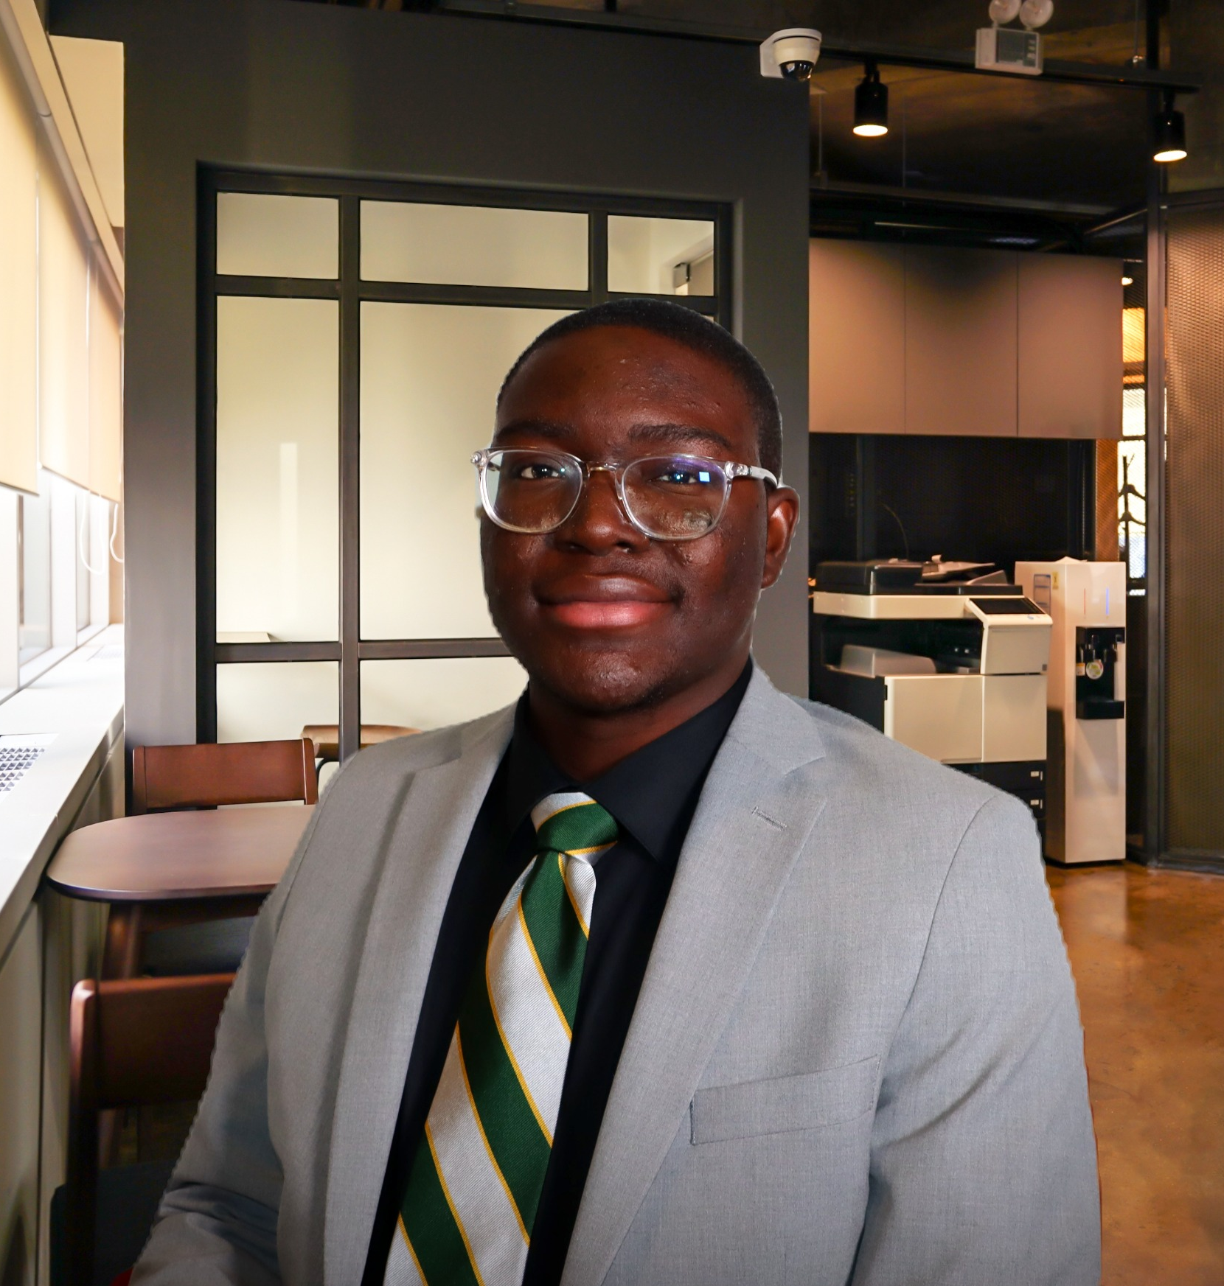

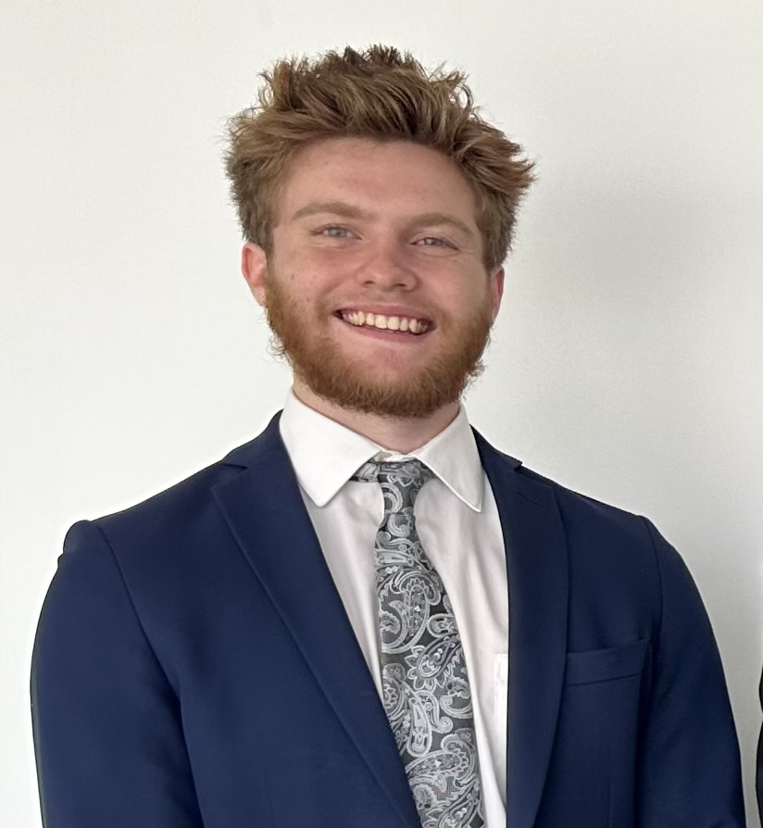
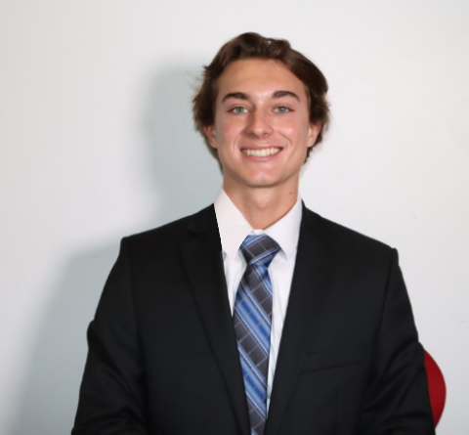

Jake Adamczewski
Kennedy Garrett
Prince Johnson
Laci Provenzano
Christian Sickmeier
Indiana University – Indianapolis | Kelley School of Business | Honors I-Core

Slide 3
Agenda
Introduction
AI Capabilities in the Financial Tech Industry
Development Timeline
Marketing and Promotion
Finances – Part 1: How is FinTime Funded?
Finances – Part 2: The FinTime Budget?
Recommendation
Open Forum
Notes:
Introduction – Prince Johnson
Who We Are / Values
Value Proposition / target market
The Financial Planning Industry – Jake Adamczewski
SWOT Analysis
Environmental Scan (and competitors)
Explanation of Product Concept – Kennedy Garrett
How does the product work?
How is ChatGPT included in this product?
Brief overview of technical requirements/details.
Marketing and Promotion (Laci Provenzano and
Shawn and ICP (Christian Sickmeier)
How FinTime will promote itself and gain clients?
Regional Reps
Promotional Plan
Finances – Part 1: How is FinTime Funded? (Prince Johnson)
Funding source
Pricing
Overview of Year 0 costs
Development Timeline (Jake Adamczewski)
Finances – Part 2: The FinTime Budget? (Christian Sickmeier)
Outline of development costs.
Overview of financial statements
Overview sales forecast
Recommendation – Prince Johnson/Kennedy Garrett
Conclusion – Kennedy Garrett/Prince Johnson

Slide 4
AI Capabilities in the Financial Tech Industry

Slide 5



Strengths of AI Capabilities
Enhanced Customer Engagement
Natural Language Processing
Continuous Improvement

Slide 6



Weaknesses
Algorithm Bias
Lack of Human Originality
Variable Response Accuracy
Notes:
* Change animations *

Slide 7



Opportunities
Client Dissatisfaction in Communication
Sustainable Investment Opportunities
Comfort in AI Advice

Slide 8



Threats
Cybersecurity and Safety Concerns
Bloomberg’s AI Initiative
DIY Investing Trend
Notes:
Add animations, fix spacing

Slide 9
How Does the FinTime App Work?

Slide 10





Opening of the App
Menu Items
Input financial data
Set Client Investment Goals
Generate reports and create recommendations
Invest for the Client
Onboard Client
Clients Tab
Research
Generic Cycle of Use for App
Profile
Settings
Customer Support
Notes:
Opening Screen of App
Client Tab
Research
Profile
Settings
Customer Support
This product is an app that will assist financial advisors. Once an advisor logs into the app they will see 5 tabs. These include the client tab, research, profile, settings, and customer support.
On the client tab the advisor will be able to select a client and edit and input the client’s data, do goal setting, be able to trade, and do investment analytics as well as print off reports generated by ChatGPT 4. The research tab is connected to ChatGPT 4. Through using this tab advisors can generate portfolios, generate reports, create recommendations for clients, help advisors research stocks and other financial information. The profile tab holds the financial advisor’s information. Lastly the customer support tab will allow advisors to talk to the support when they are struggling with the app.
FinTime app will have a cloud server that stores its data. It will also have a special database that gathers financial information. However, most information will be pulled from ChatGPT 4 since as of now it provides that service.
Efficiency of app

Slide 11
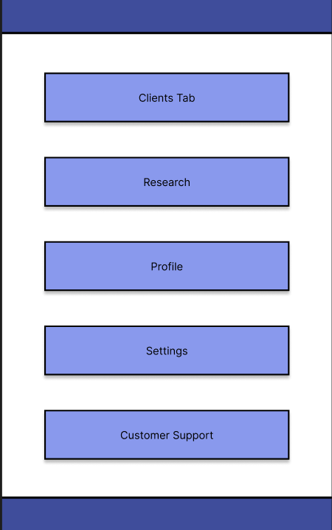
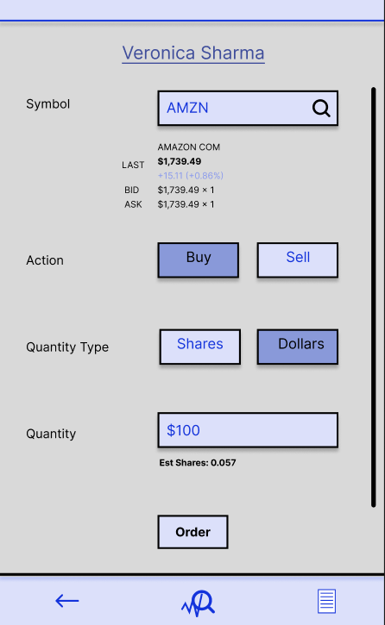
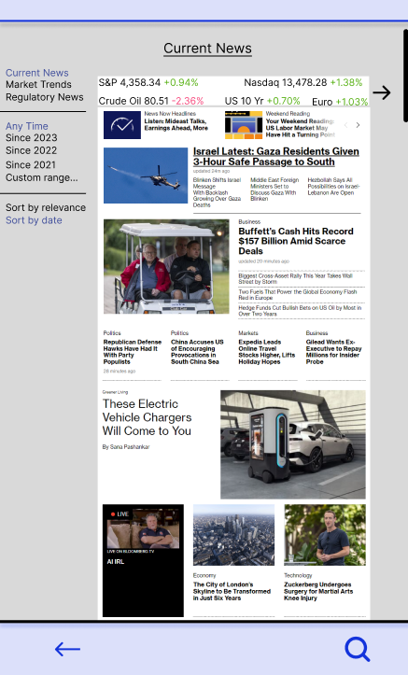
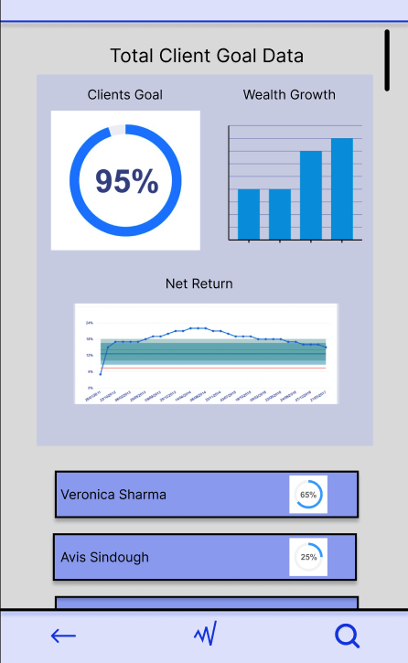
Wireframes
Notes:
Trading/Investment
Navigation Page

Slide 12
Development Timeline

Slide 13
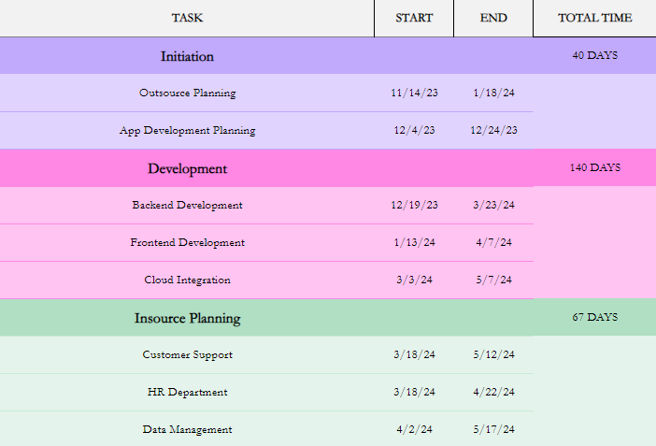
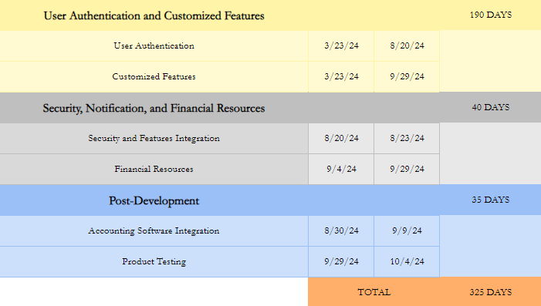
Development Timeline

Slide 14
Marketing and Promotion

Slide 15


Shawn The Financial Advisor
About Shawn
Age: 44
Education: BS in Finance
Location: New York, NY metro area
Income: High
Shawn
Notes:
· Professional Profile:
o Age: 44
o Gender: Male
o Education: Bachelor’s degree in Finance
o Location: New York
o Income: High income
· Career Snapshot:
o Job Title: Senior Financial Advisor
o Clients: 115
o Company Size: <200 employees
· Goals and Challenges:
o Goal: Deliver exceptional financial services, helping clients achieve objectives
o Challenge: Efficiently manage a growing client base while maintaining personalized service
· Personal Life:
o Family: Married with three children
o Hobbies: Enjoys hiking and reading
o Values: Emphasizes work-life balance and quality family time
· App Benefits for Shawn:
o AI-powered system simplifies portfolio management, saving time
o Personalized portfolio recommendations align with client objectives
o Provides real-time updates on market trends and regulatory changes, saving research time
o Scalability allows Shawn to serve more clients effectively without sacrificing quality

Slide 16
Target Market
Streamline Portfolio Management
Automate tasks
Real-Time Market Insights
Innovative AI algorithms and features
Prioritize
- Time efficiency
- Scalability
- Advanced technology integration
Shawn
The Financial Advisor
Notes:
There are a few things that both Shawn and FinTime’s target market look for in financial advisory software…

Slide 17




Message Theme
Support marketing efforts with…
Ease
Reliability
Security
Positive Testimonials
Competitive Data Showcasing Efficiency
Commitment to User Feedback
Notes:
The message …. Rational approach … sets itself apart ….
Ease, reliability, security
Support marketing efforts with positive data testimonials
Competitive data showcasing efficiency
Commitment to User Feedback

Slide 18

Core Values
Trust
Commitment to Continuous Improvement
Notes:
Core values and commitment
Maybe mission statement and maybe all values

Slide 19
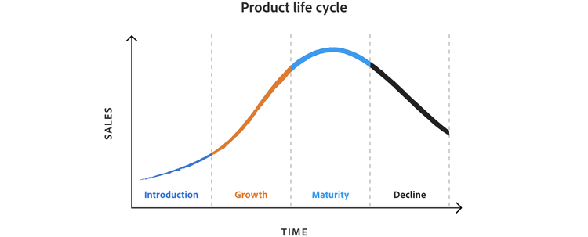
Product Life Cycle (PLC)

Slide 20


Promotional Plan Months 0 – 6 (Pre-App Launch)
Promotional Plan Goal(s)
Increase brand awareness by 25%
Acquire 1,390 financial advisors before product launch
Promote with social media teasers, webinars, exclusive access, and partnerships.
Highlighting…
Ease of use, reliability, security, comprehensive functionality, commitment to feedback
Notes:
Every period has a section

Slide 21
Promotional Plan Months 7 – 12 (App launched at Month 6)
Promotional Plan Goal(s)
Acquire a minimum of 2,780 customers
Gather 278 positive reviews within the first 6 months.
Promote through launch events, user testimonials, social media blitz, and market research.
Building…
Credibility, trust, and positive reviews.
(Understanding target market needs through feedback)
Notes:
Every period has a section

Slide 22
Promotional Plan Months 13 – 24 (Building Community)
Promotional Plan Goal(s)
Acquire a minimum of 4,170 users
Have at least 25% of users come from referrals.
Promote through referral programs, feature updates, user surveys, and content marketing.
Focusing on…
Foster community, showcase high-tech capabilities, increase customer loyalty, and market awareness.
Understand user experiences for continuous improvement.
Notes:
Every period has a section

Slide 23
Promotional Plan Months 25 – 36 (Market Expansion)
Promotional Plan Goal(s)
Hold at least 3.875% of market share
Begin expansion into international markets
(select test locations in Mexico and Canada)
Establish thought leadership.
Promote through thought leadership, advanced training, market expansion, sales force expansion, and onboarding new hires.
Focusing on…
brand authority, encouraging user proficiency, increase the target market size, improve customer relations, and maintain a positive user experience during expansion.
Notes:
Every period has a section

Slide 24



Communication Media
Emphasizing Efficiency and Advanced Tools
Creating Buzz and Excitement
Enhancing Brand Visibility
Notes:
Communication Media

Slide 25
Finances Part 1: Financial Requirements

Slide 26
Funding Sources
$24.78 million
$3.49 million + 21.29 million
How Can This Be Funded?
Crowdfunding activities
Personal Investment
Private Equity
Commercial Loan

Slide 27
Finances Part 2: The FinTime Budget

Slide 28
Required Net Working Capital Investment
Required Net Working Capital Investment
Year | 0 | 1 | 2 | 3 | 4 | 5
NWC Requirement | $3,490,468 | $3,978,180 | $5,967,270 | $7,956,360 | $7,956,360 | $7,956,360
Initial NWC | 3,490,468 | - | - | - | - | -
∆NWC | (3,490,468) | (487,712) | (1,989,090) | (1,989,090) | - | -
NWC recovery | - | - | - | - | - | 7,956,360
Total ∆NWC | (3,490,468) | (487,712) | (1,989,090) | (1,989,090) | - | 7,956,360
Notes:
Just the table
Where the 3.4 million comes from
NWC requirement?

Slide 29
Pro-Forma Income Statement
Pro-Forma Income Statement
Year | 1 | 2 | 3 | 4 | 5
Sales | $26,521,200 | $39,781,800 | $53,042,400 | $53,042,400 | $53,042,400
Variable Costs | 16,421,094 | 24,448,350 | 32,944,434 | 32,006,202 | 33,067,969
Fixed Costs | 4,626,448 | 4,626,448 | 4,626,448 | 4,626,448 | 4,626,448
Depreciation | 4,266,599 | 4,266,599 | 4,266,599 | 4,266,599 | -
EBIT | 1,207,056 | 6,440,401 | 11,204,916 | 11,143,149 | 11,081,381
Taxes | 422,469 | 2,254,140 | 3,921,720 | 3,900,102 | 3,878,483
Net Income | 784,587 | 4,186,260 | 7,283,195 | 7,243,047 | 7,202,898
Year 1 – 38.1%
Year 2 – 38.5%
Year 3 – 37.9%
Year 4 – 37.8%
Year 5 – 37.7%
Notes:
C/M
Net Income

Slide 30
Operating Cash Flow
Salaries
Years 1 and 2
$2.7 million and 26 staff
Operating Cash Flow
YEAR | 1 | 2 | 3 | 4 | 5
EBIT | $1,207,057 | $6,440,401 | $11,204,916 | $11,143,149 | $11,081,381
Depreciation | 4,266,600 | 4,266,600 | 4,266,600 | 4,266,600 | 4,266,600
Taxes | 422,470 | 2,254,140 | 3,921,721 | 3,900,102 | 3,878,484
Operating Cash Flow | 5,051,187 | 8,452,860 | 11,549,795 | 11,509,646 | 11,469,498
Years 3 – 5
$3.1 million and 31 staff
NPV: $2, 397, 353
IRR: 23%
Notes:
Include tables, add NPV, IRR, include salaries totals

Slide 31
Sales Forecast
 | Forecasted Clients | Forecasted Revenue
Year 1 | 2780 | $26,521,200
Year 2 | 4170 | 39,781,800
Year 3 | 5560 | 53,042,400
Year 4 | 5560 | 53,042,400
Year 5 | 5560 | 53,042,400
 | Cost | Client Distribution
Tier I | $450 / month | 15%
Tier II | 850 / month | 75%
Tier III | 900 / month | 10%
Notes:
Client distribution and total clients and annual revenue

Slide 32
Recommendation

Slide 33




Recommendation
Viable Target Market
Proceed!
Viable Product Technology

Slide 34
Open Forum

Slide 35
Appendix

Slide 36
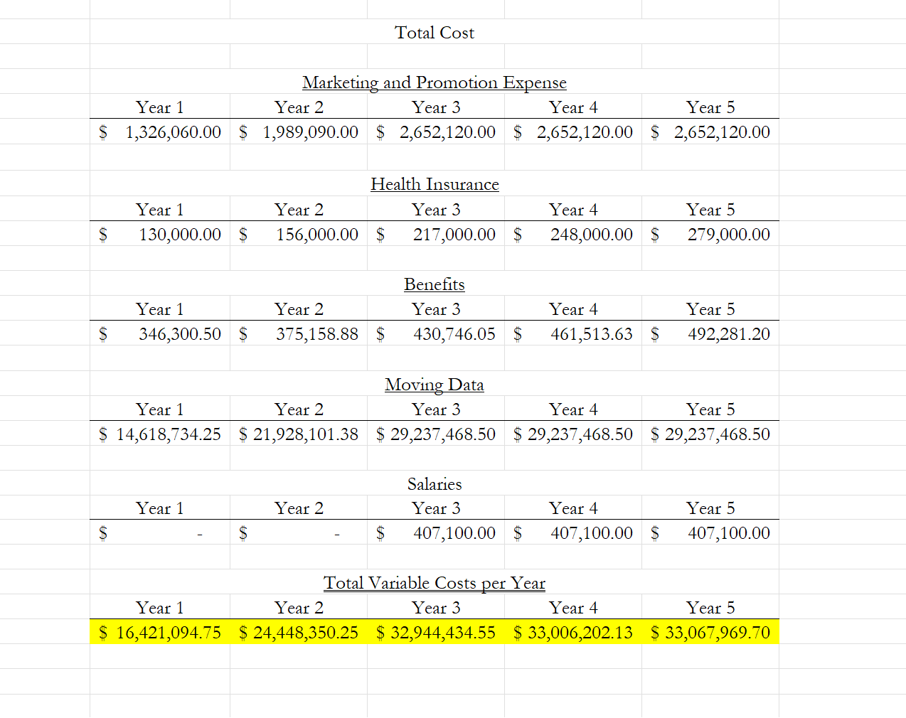
Variable Cost

Slide 37
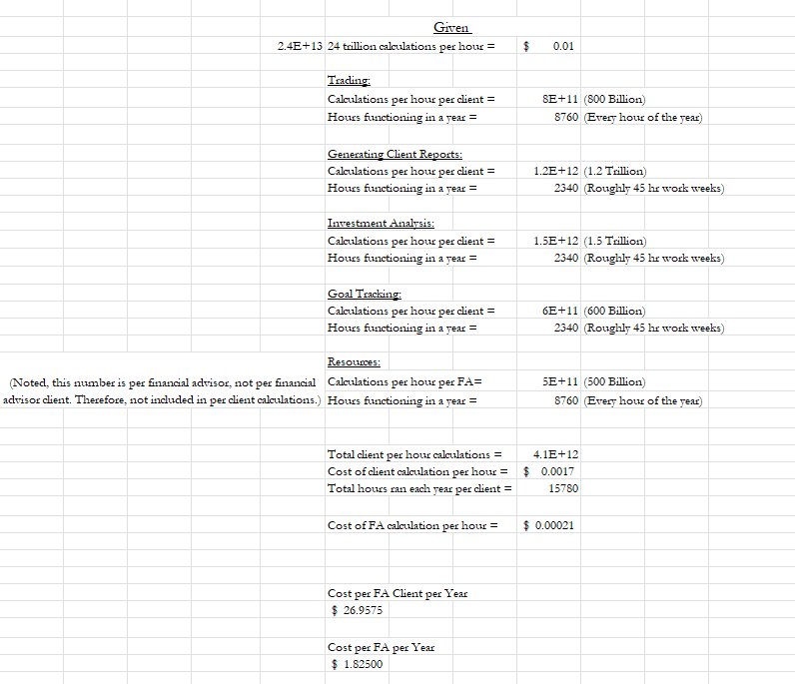
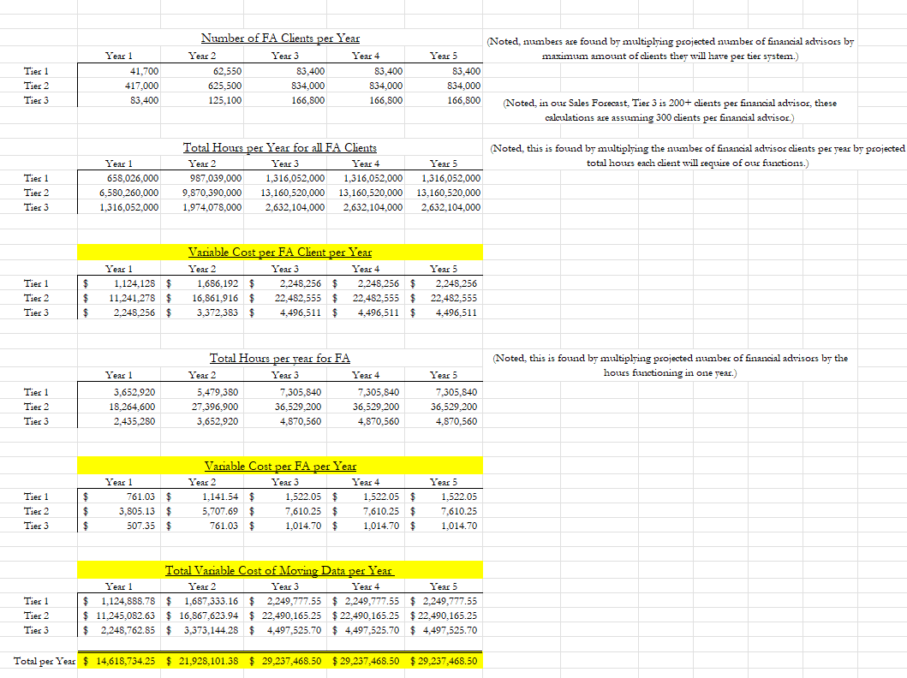
Variable (Cost of Moving Data)

Slide 38
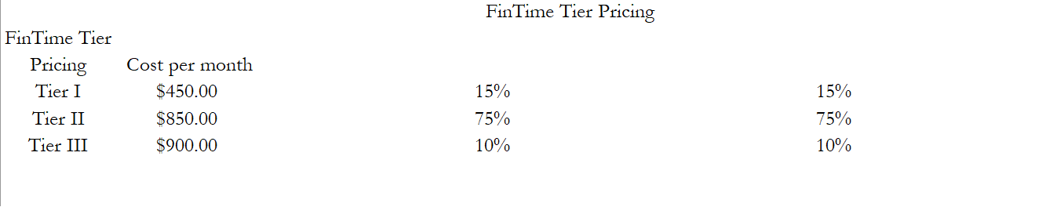
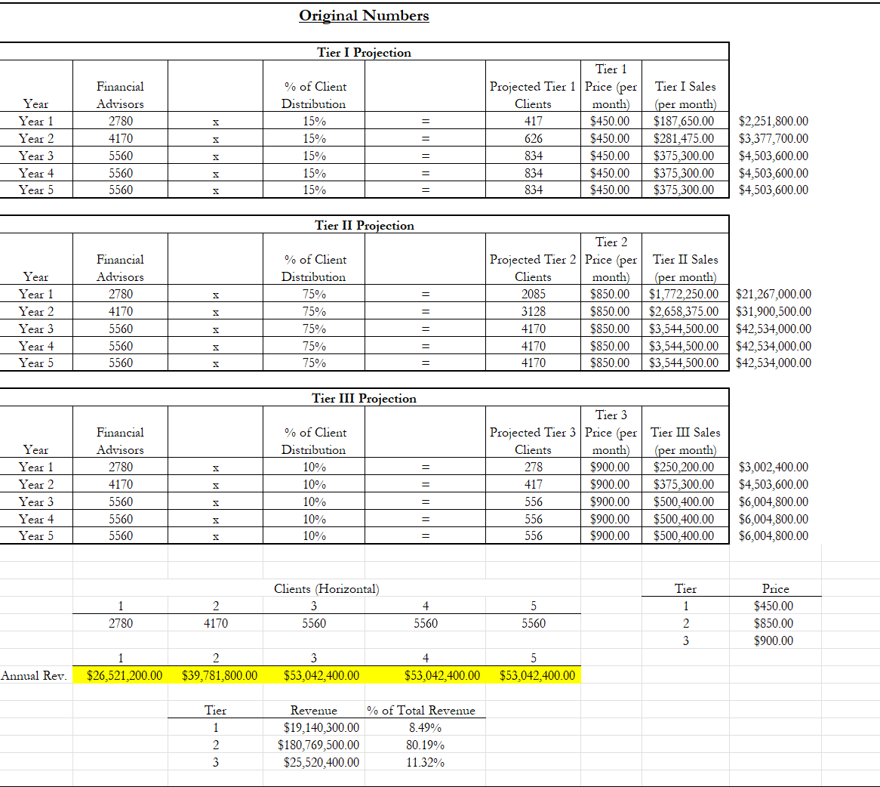
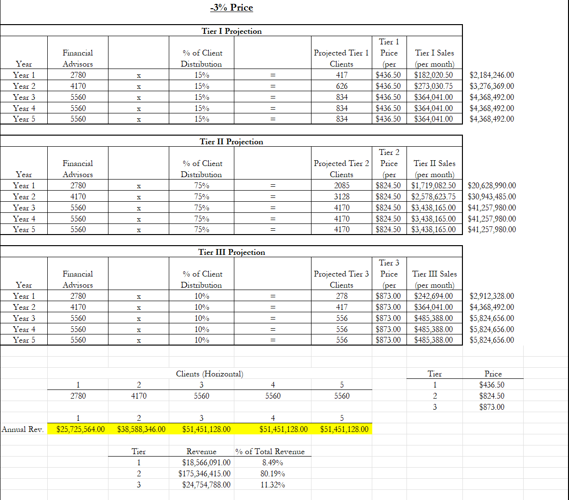
Sales Forecast

Slide 39
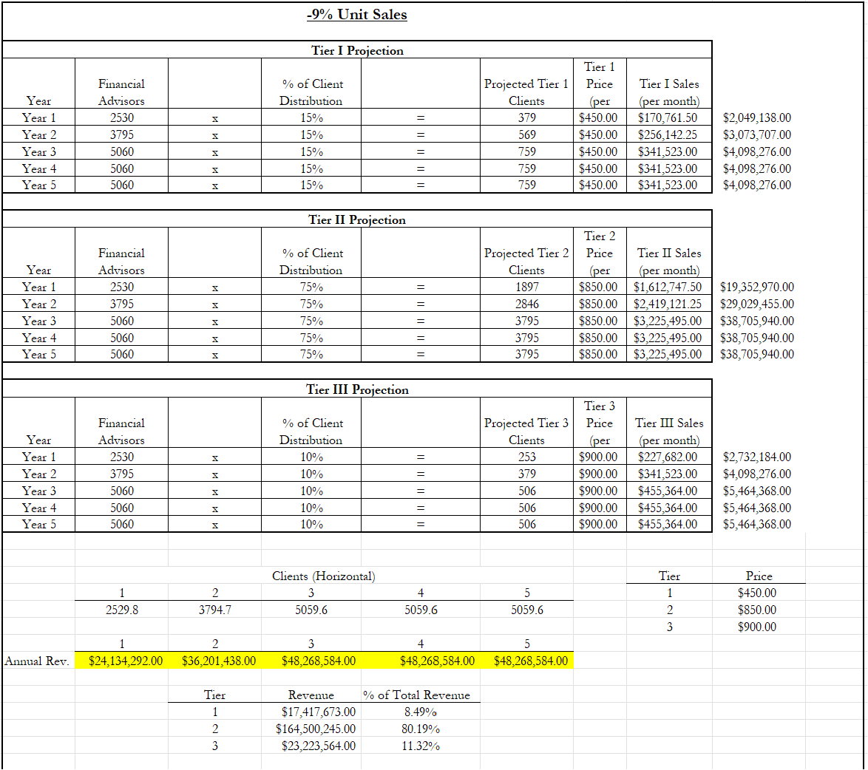
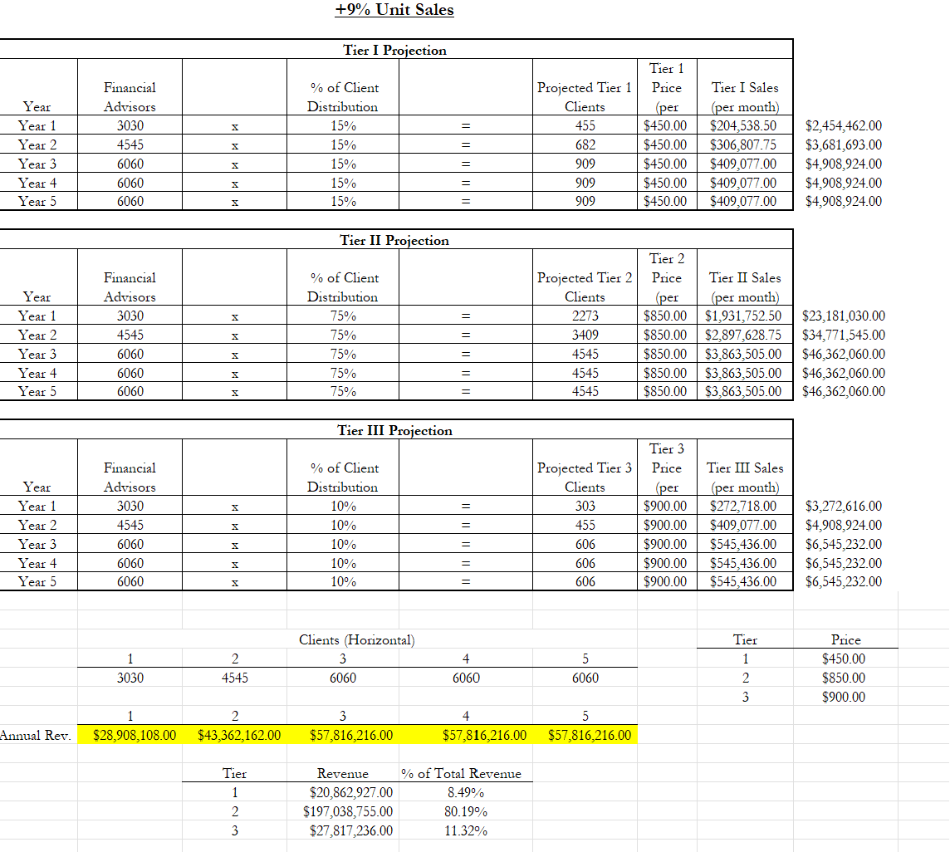
Sales Forecast

Slide 40
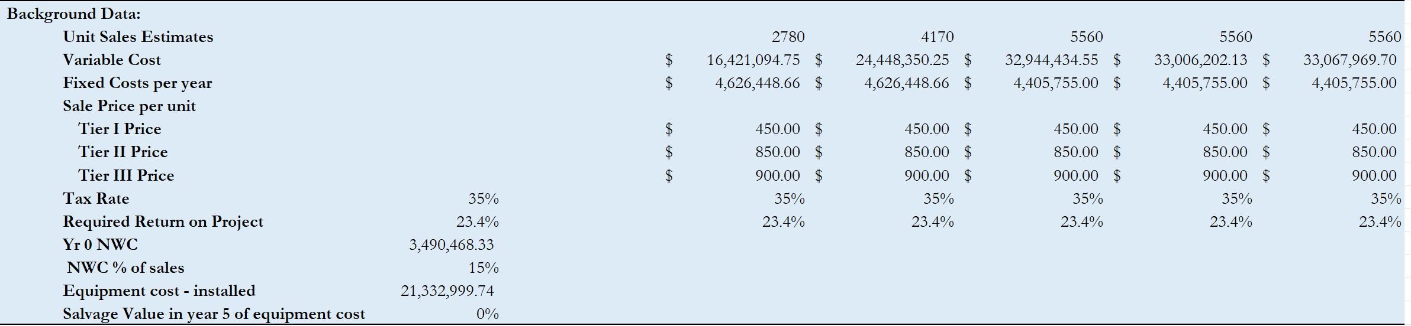
Sensitivity Analysis +3.4 required return

Slide 41
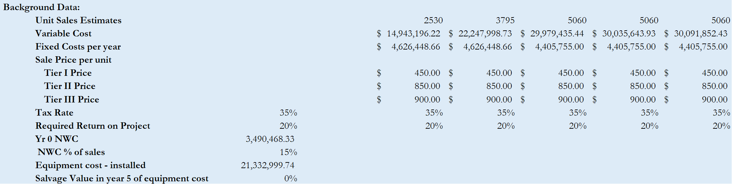
Sensitivity Analysis –9 Unit Sales

Slide 42
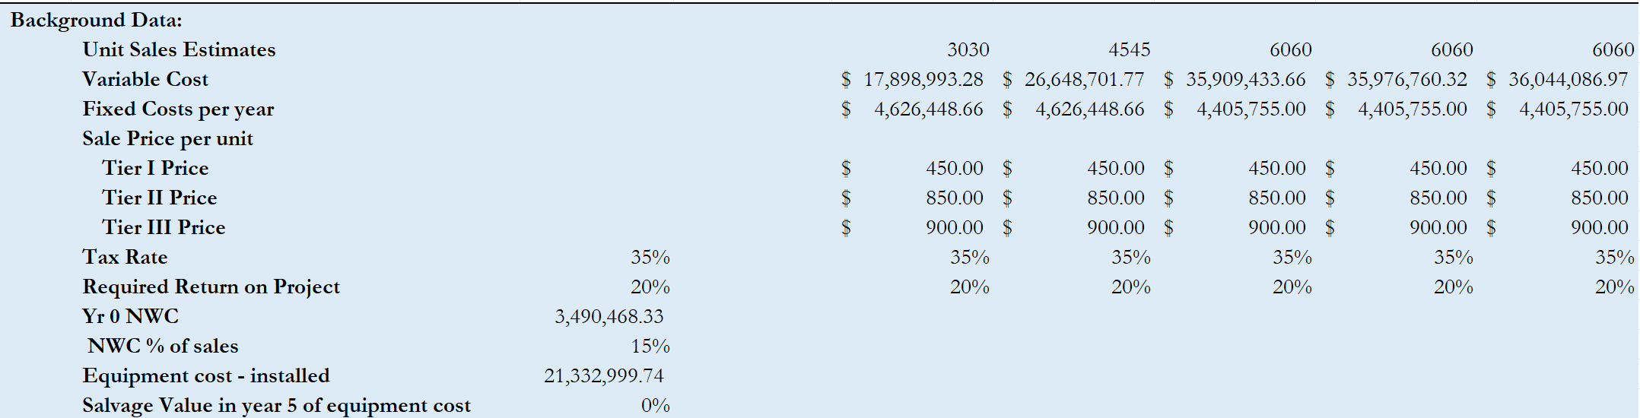
Sensitivity Analysis +9 Unit Sales

Slide 43
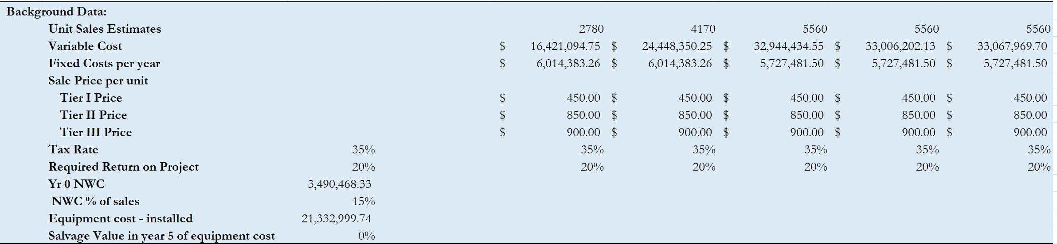
Sensitivity Analysis +30% Fixed Cost

Slide 44
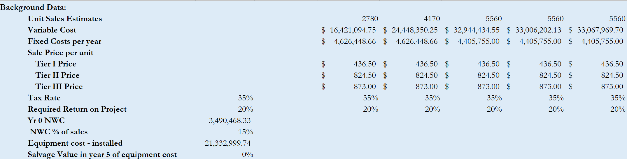
Sensitivity Analysis –3% Price

Slide 45
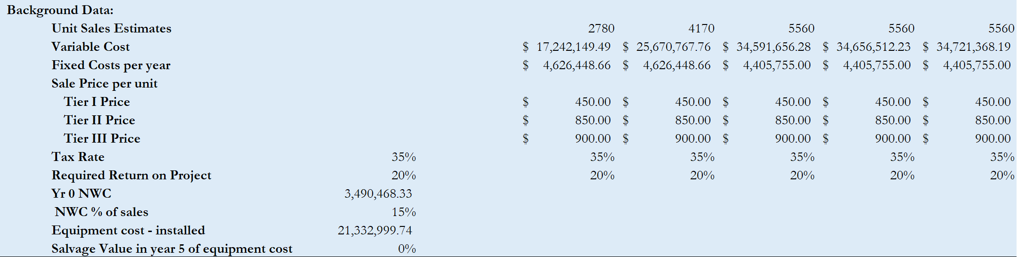
Sensitivity Analysis +5% Variable Cost

Slide 46
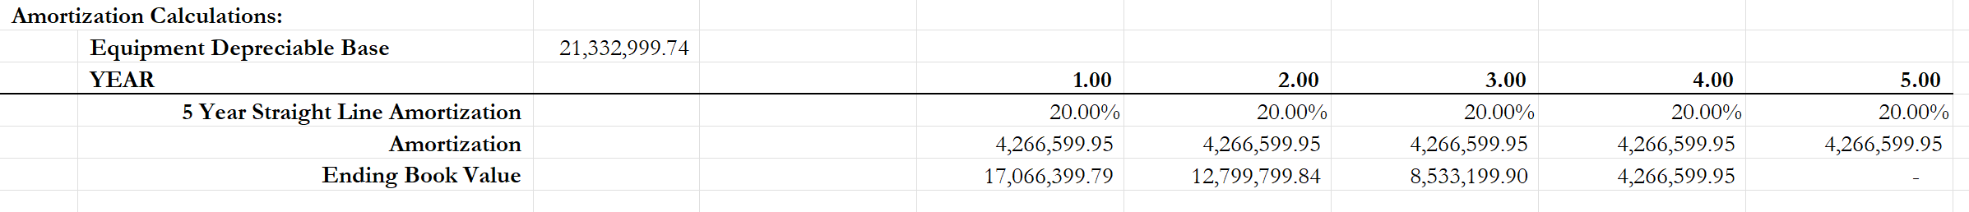
Amortization

Slide 47
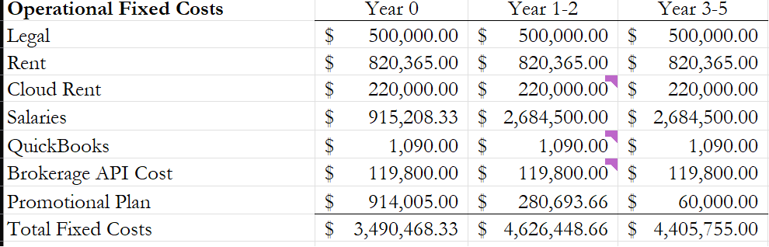
Operational Fixed Cost

Slide 48
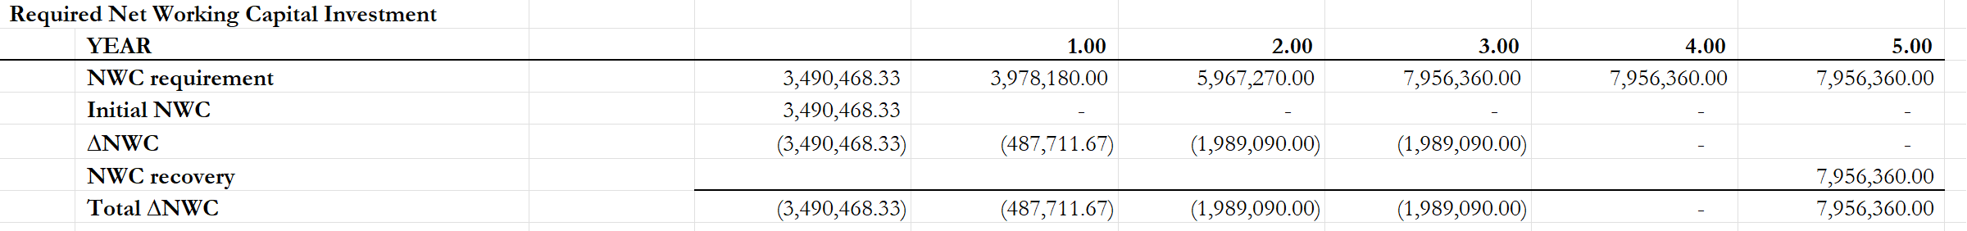
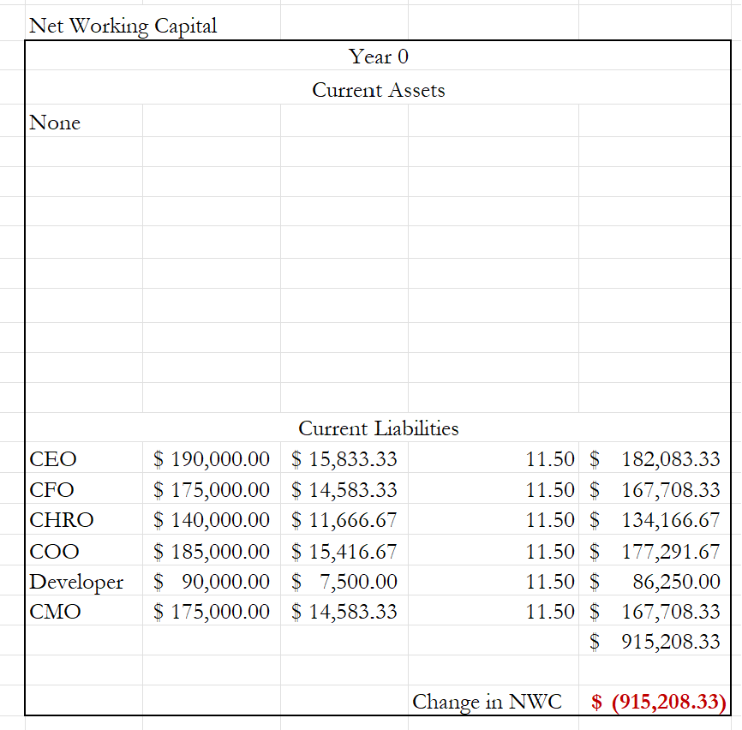
Net Working Capital

Slide 49
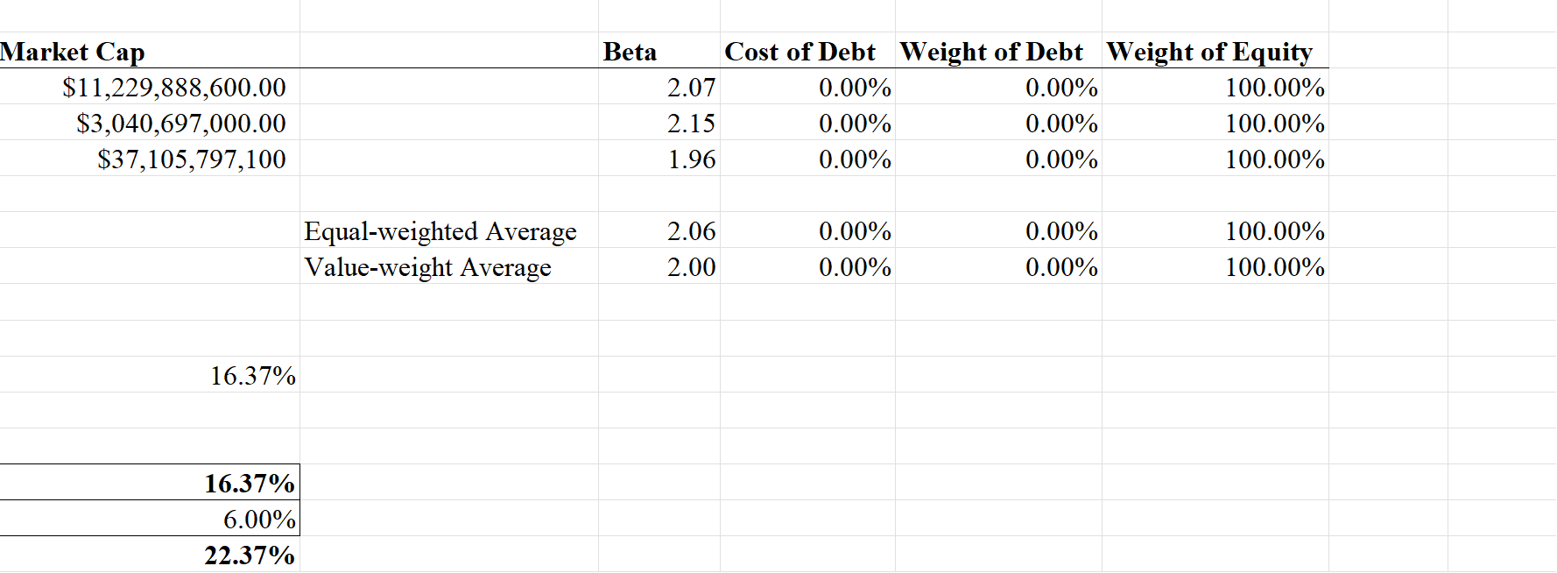
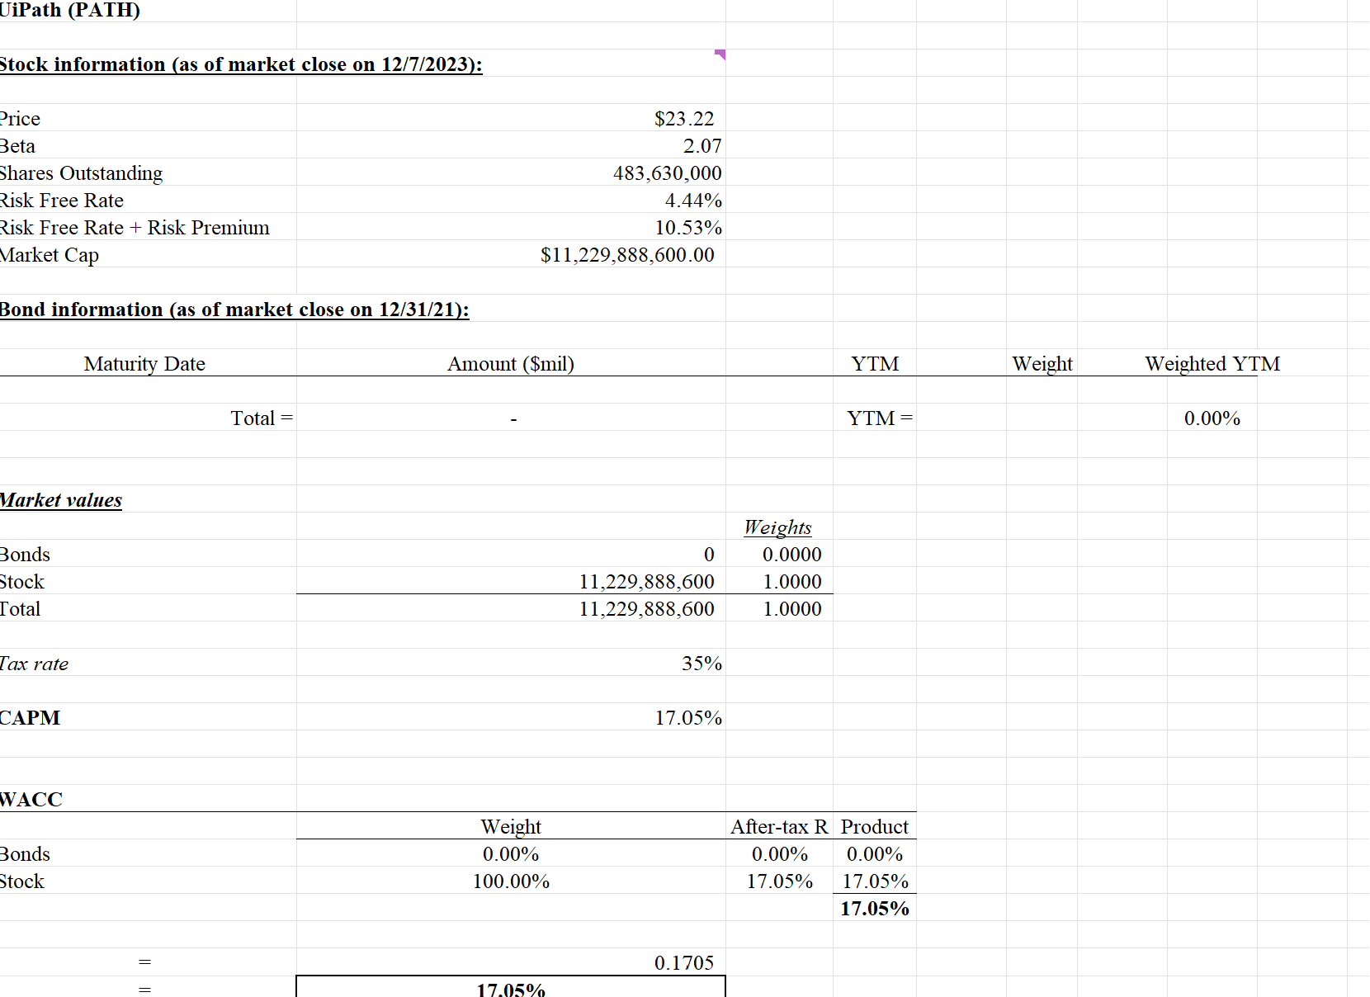
WACC

Slide 50
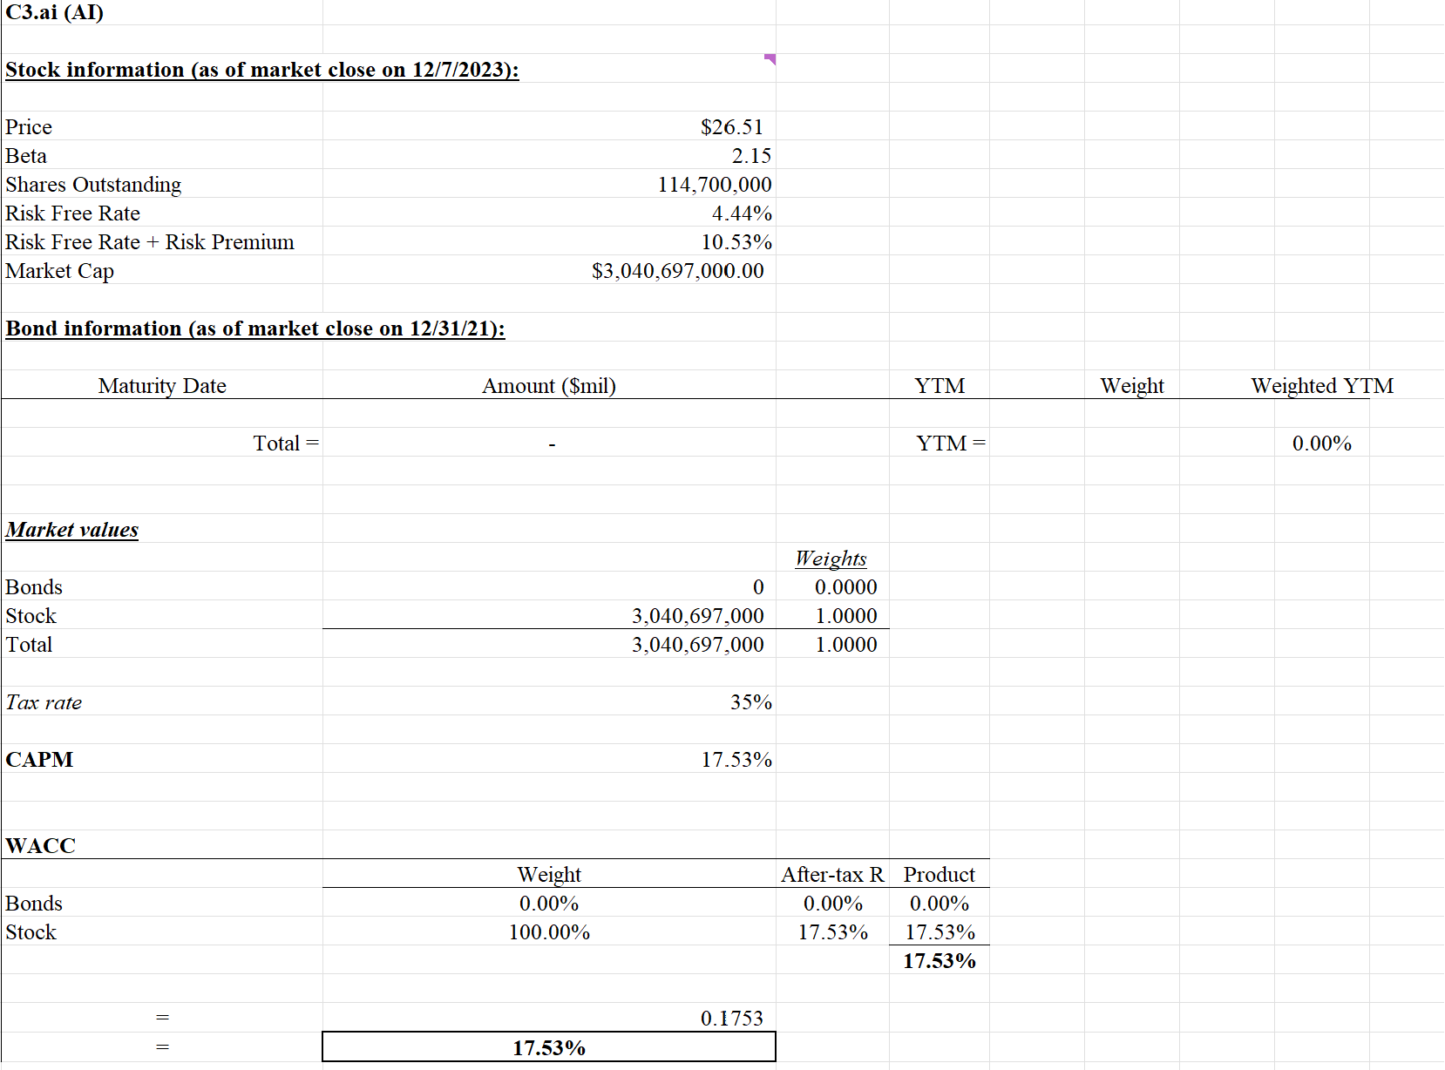
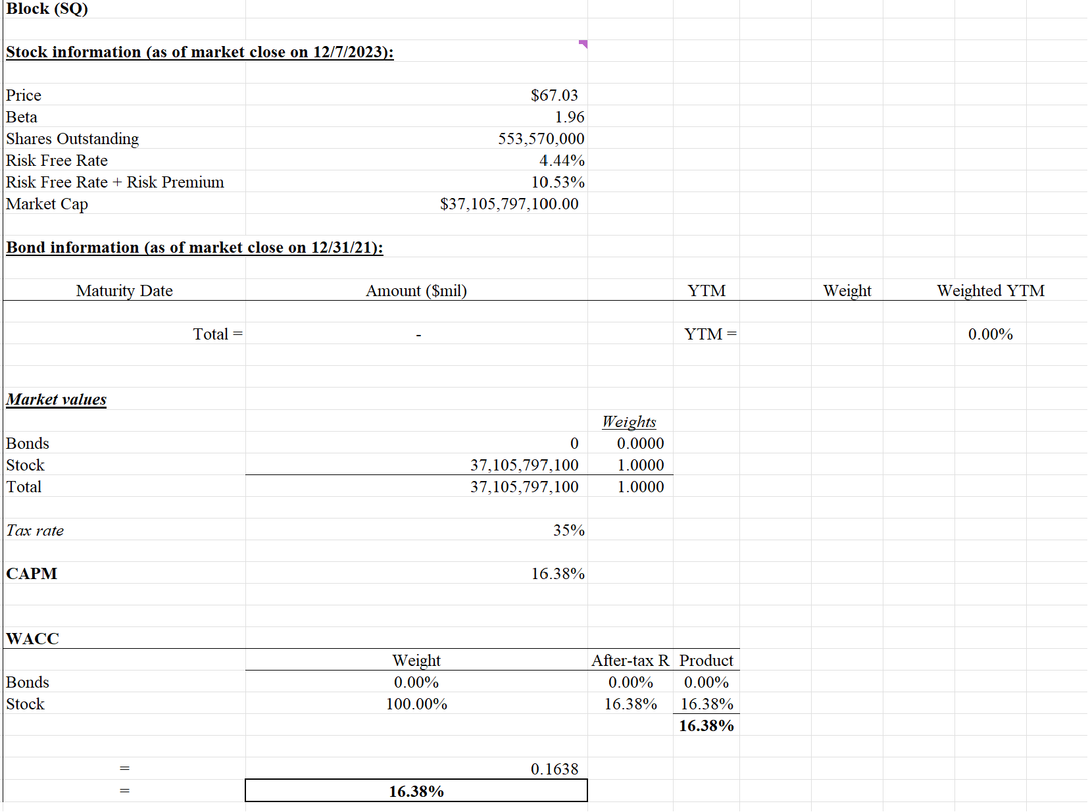

Slide 51
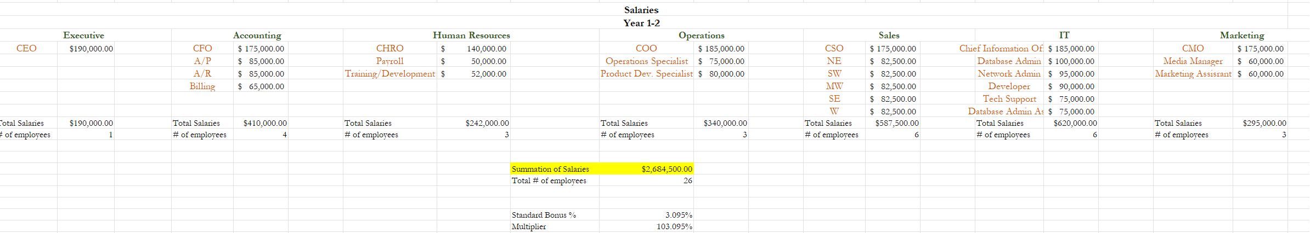
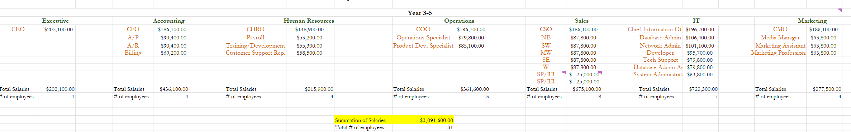
Salaries

Slide 52
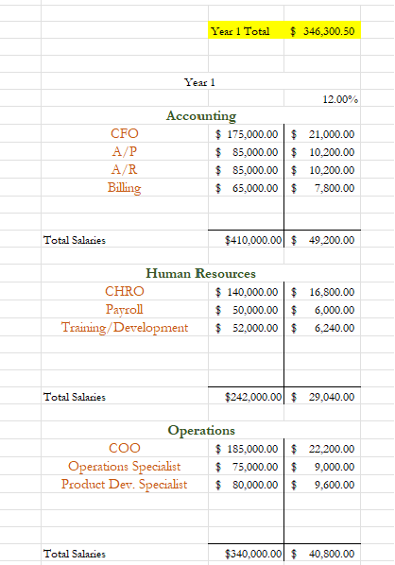
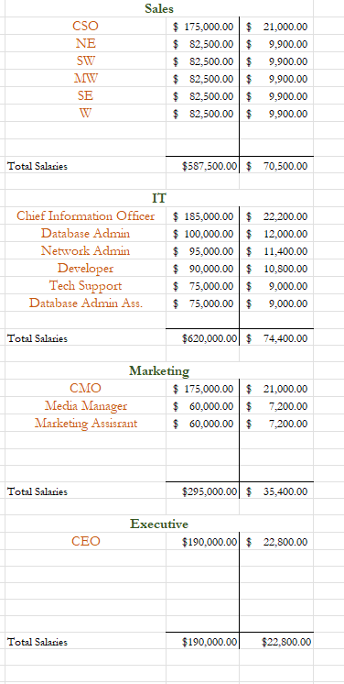
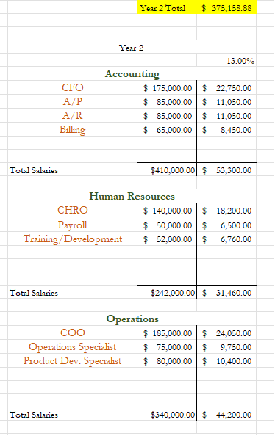
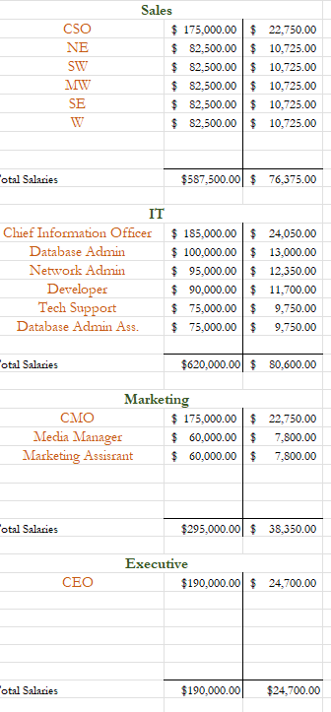
Benefits Year 1 & Year 2

Slide 53
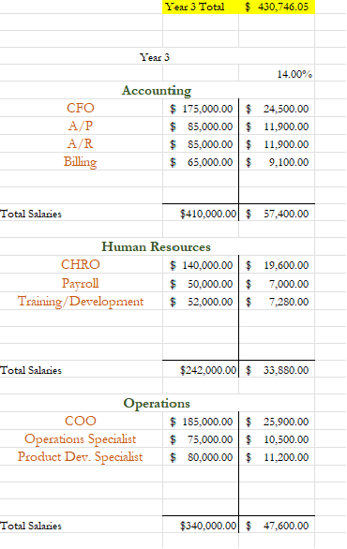
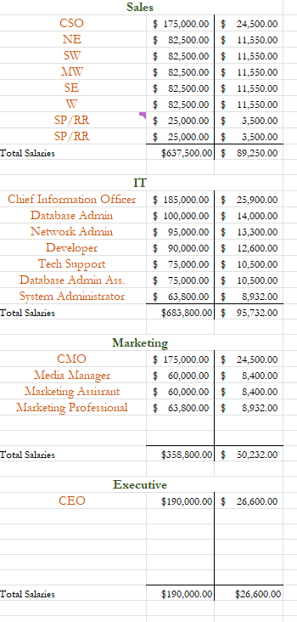
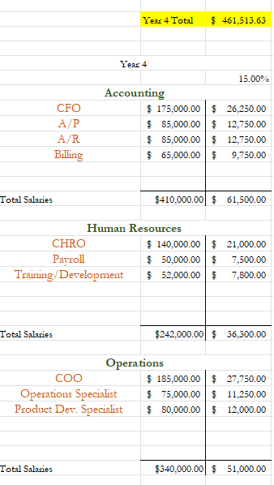
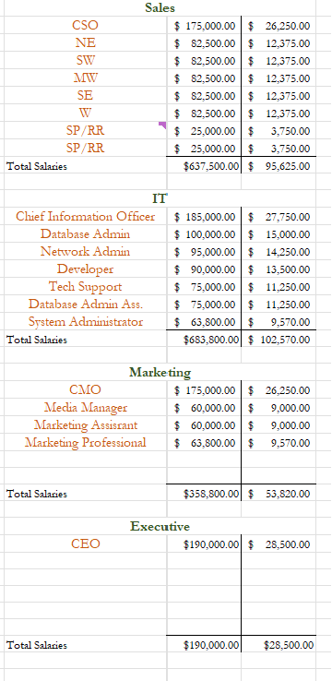
Benefits Year 3 & Year 4

Slide 54
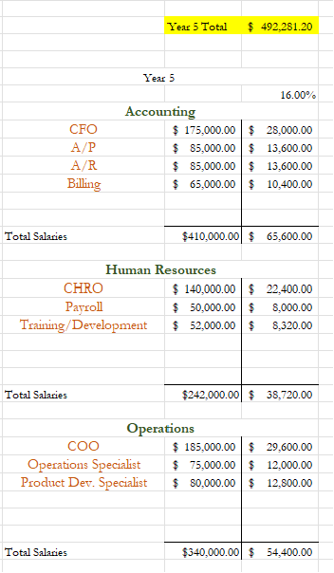
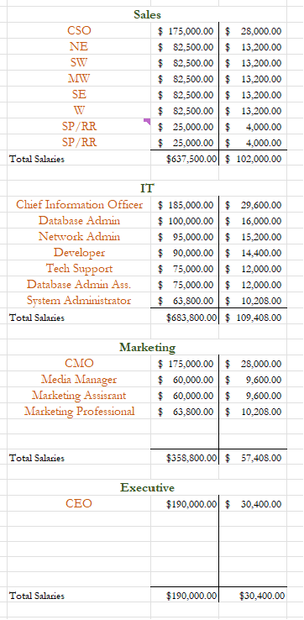
Benefits Year 5

Slide 55
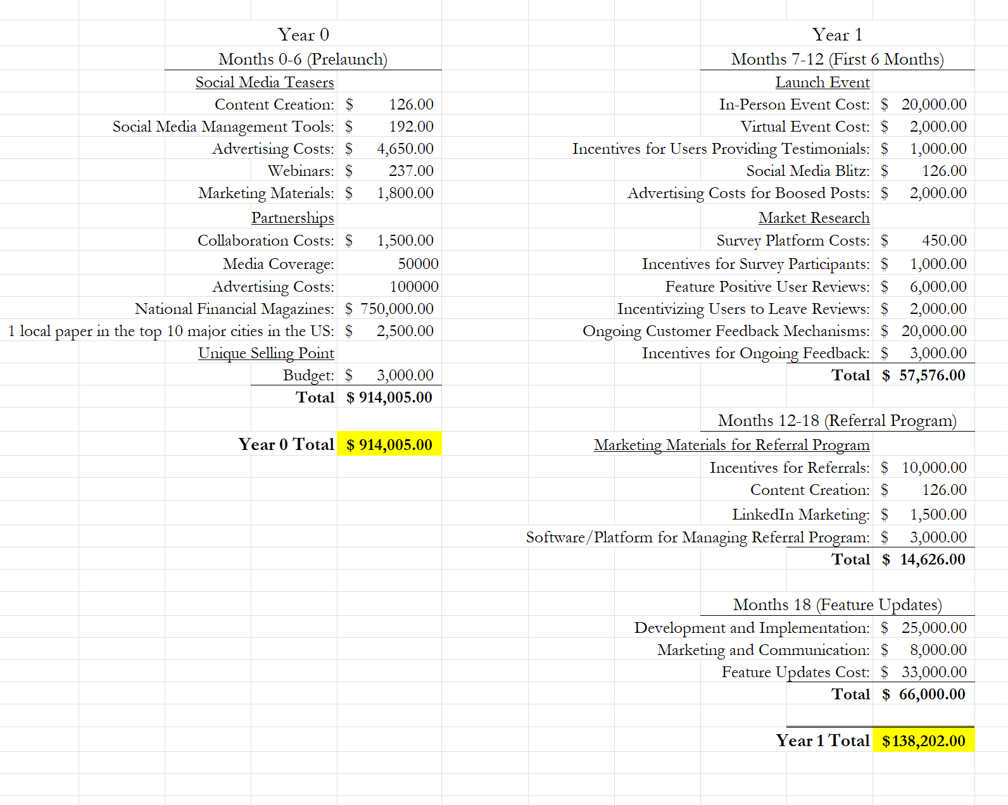
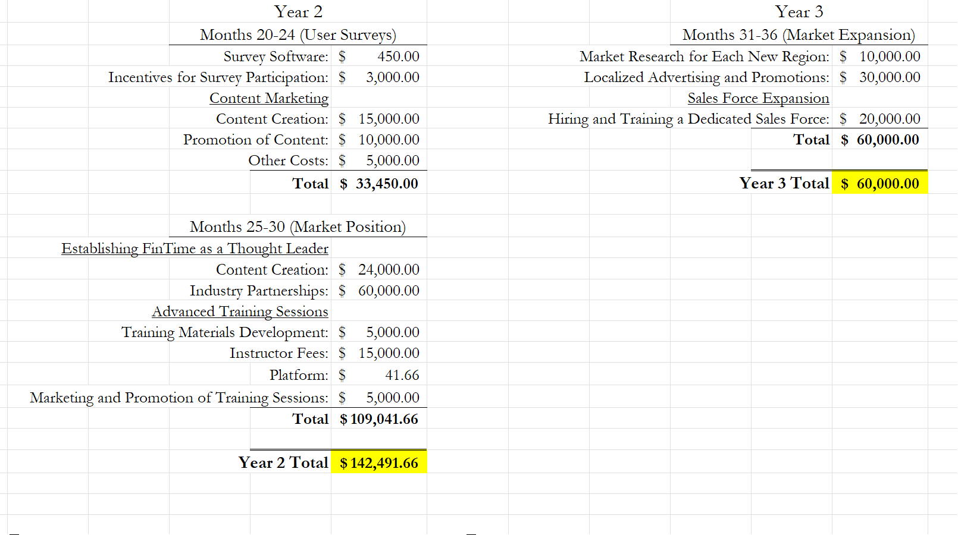
Promotional Plan

Slide 56
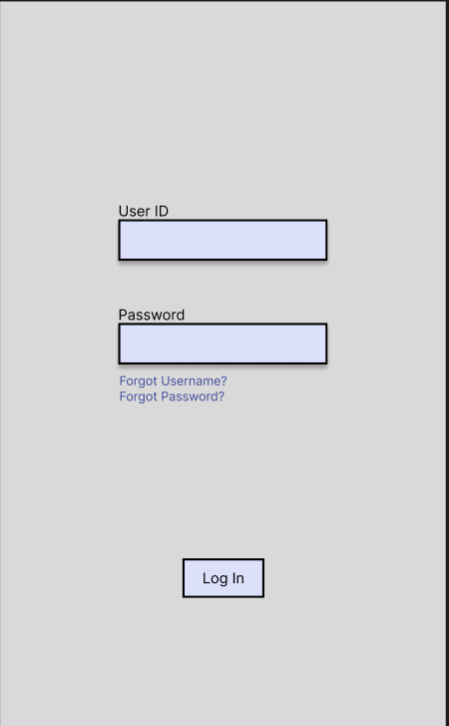
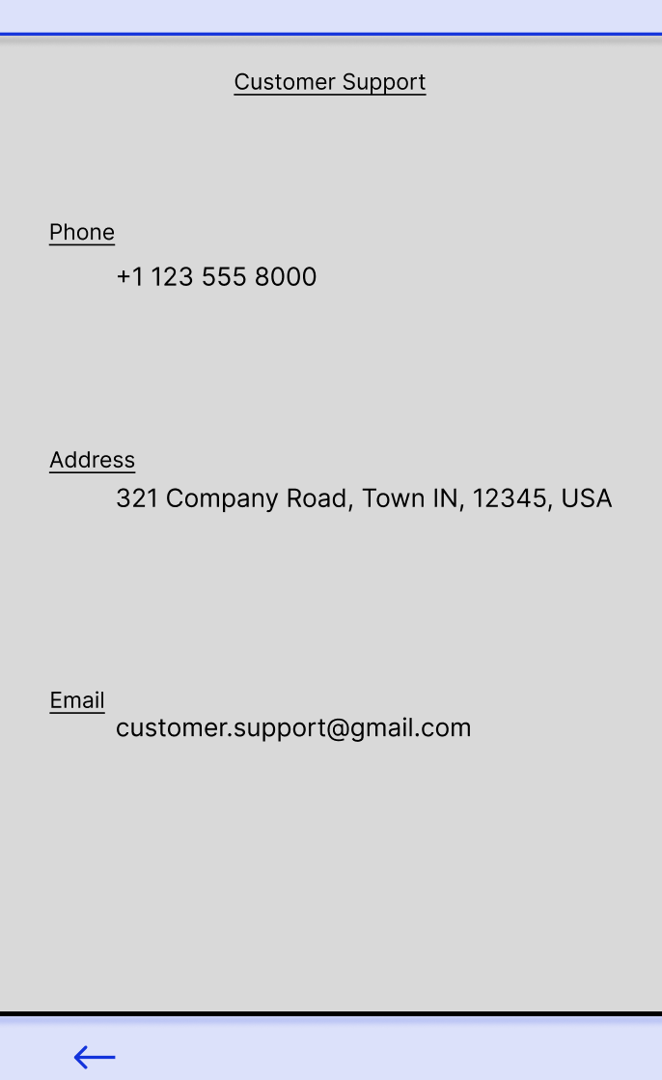
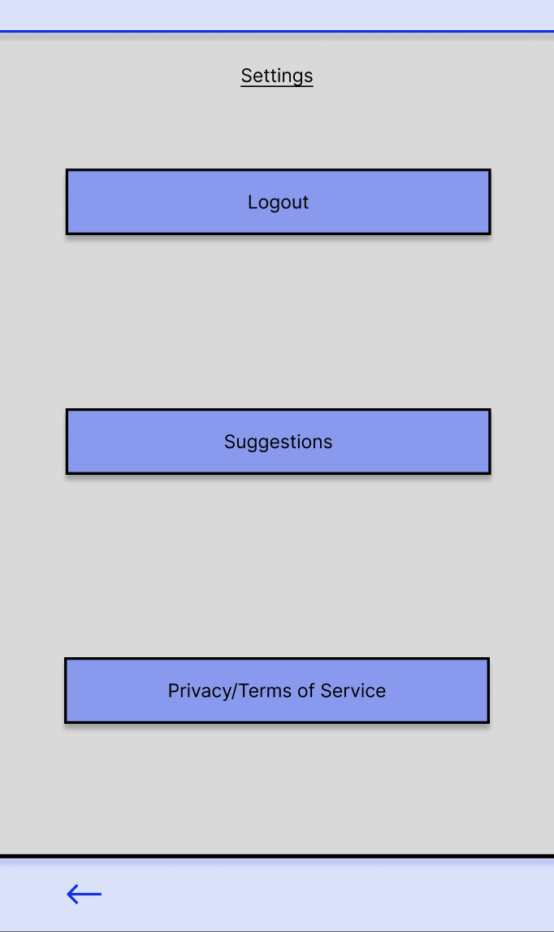
Wire Frames

Slide 57
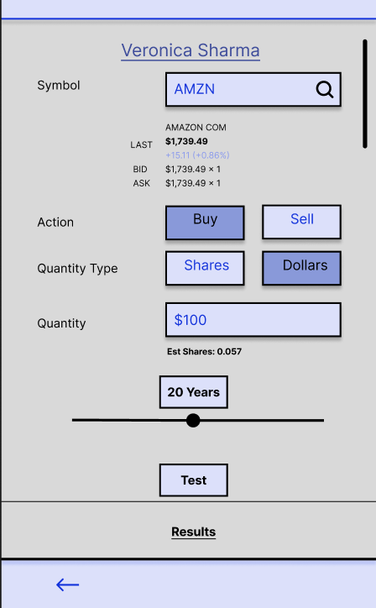
Wire Frames
Notes:
Trading/Investment
Navigation Page

Slide 58




Wire Frames

Slide 59


Wire Frames

Slide 60

SWOT

Slide 61


Client Documents – Investment Analytics

Slide 62



Client Documents – Investment Analytics

Slide 63


Client Documents – New Client Form

Slide 64


Client Documents – New Client Form

Slide 65


Client Documents – New Client Form

Slide 66


Client Documents – New Client Form

Slide 67

Client Documents – New Client Form

Slide 68


Efficiency of FinTime

